Slide 1



Introduction to R and RStudio
Session 7: Relational data (Joins)

Slide 2
Relational data
It’s rare to find all the data you need for an analysis in a single table.
Typically, you’ll have to link two (or more) tables together by matching on common “key” variable(s).
We use joins in SQL or R (or VLOOKUP in Excel)

Slide 3
Relational data
Here, we’ll focus on left (outer) joins.
The syntax is similar for other types of join.

Slide 4
left_join
table_1 %>%
left_join(table_2, by = “x”)
Keep structure of table_1
…and match to observations in table_2
“key” variable (common to both tables)

Slide 5
Relational Data
We’re going to join two tables - one with cases of tuberculosis by country, one with population by country. From this new table we can derive a rate.
cases
pop
country | year | cases
A | 1999 | 5
B | 1999 | 9
country | year | pop
B | 1999 | 500
A | 1999 | 3000

Slide 6
Please Import
tb_cases.csv
and
tb_pop.csv

Slide 7
left_join
Keep the original structure of the tb_cases data frame
tb_cases %>%
left_join(tb_pop, by = “country”)
…then match to rows in tb_pop
based on “country” value

Slide 8
Duplicates!
tb_cases %>%
left_join(tb_pop, by = “country”)
For every value of Brazil in tb_cases, there are 4 in tb_pop…
Brazil
Brazil
Brazil
Brazil
Brazil

Slide 9
Join on multiple rows
tb_cases %>%
left_join(tb_pop, by = c(“country” , “year”))
match on two variables
c stands for ‘combine’

Slide 10
Joining with different names
If two tables have different names for same variable:
tb_cases %>%
left_join(bad_names,
by = c(“country” = “Place” , “year” = “Yr”))
imaginary table
name in cases
name in bad_names

Slide 11
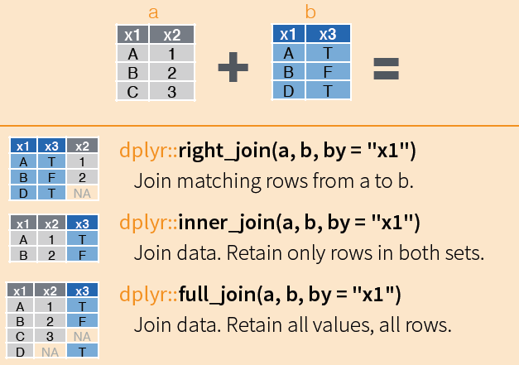
Some other dplyr joins
Image taken from: https://www.rstudio.com/wp-content/uploads/2015/02/data-wrangling-cheatsheet.pdf

Slide 12
This material was created for the NHS-R community by:
Andrew Jones @The Strategy Unit
The work is licenced under:
Creative Commons
Attribution-ShareAlike 4.0
International
To view a copy of this license, visit
https://creativecommons.org/licenses/by-sa/4.0/

Slide 13
End

